Slide 1
Advanced topics in MCMC
Kalani H
Guest lecture – STAT951

Slide 2
Overview
Auxiliary variable methods
Simulated Tempering
Slice Sampler
Perfect sampling
Coupling from the past (CFTP)

Slide 3
Auxiliary variable methods
Standard MCMC can take too long to converge.
01
Augment the state space of the variable of interest
02
Leads to chains that converge faster and require less tuning
03
Mostly used in Bayesian spatial lattice models
04

Slide 4
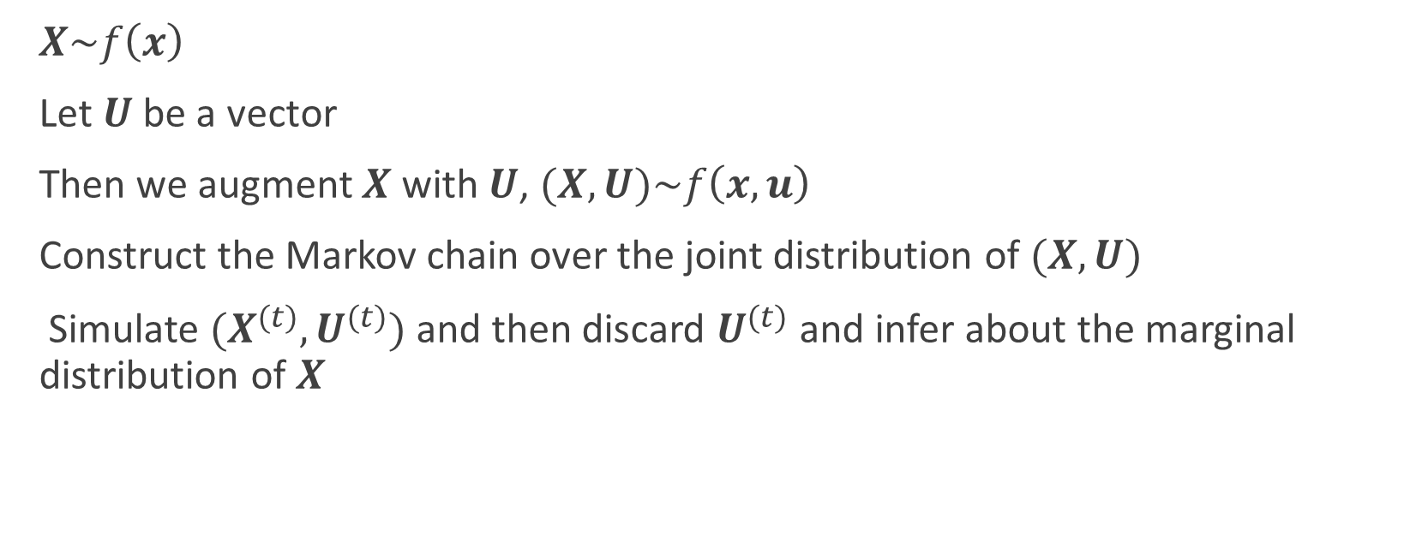
General idea
$X\sim f\left(x\right)$
Let $U$ be a vector
Then we augment $X$ with $U$, $(X,U)\sim f\left(x,u\right)$
Construct the Markov chain over the joint distribution of $(X,U)$
Simulate $(X^{(t)},U^{(t)})$ and then discard $U^{(t)}$ and infer about the marginal distribution of $X$

Slide 5
Simulated Tempering
High number of dimensions, multimodality or slow MCMC with extremely long chains
Potential solution

Slide 6
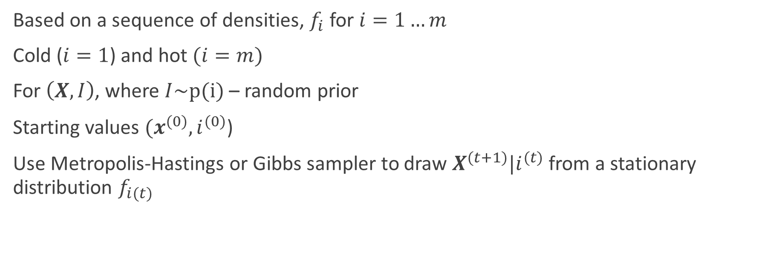
General Idea
Based on a sequence of densities, $f_{i}$ for $i=1…m$
Cold ($i=1$) and hot $(i=m)$
For $\left(X,I\right)$, where $I\sim p(i)$ – random prior
Starting values ${(x}^{(0)},i^{(0)}$)
Use Metropolis-Hastings or Gibbs sampler to draw $X^{(t+1)}|i^{(t)}$ from a stationary distribution $f_{i(t)}$

Slide 7

Generate $I^{∗}$ from a proposal density, $g(.|i^{\left(t\right)})$
$g\left(. | i^{\left(t\right)}\right)=\left\{\begin{matrix}1 if \left(i^{(t)} | i^{∗}\right)=\left(m,m−1\right) \\ \frac{1}{2} if \left|i^{∗}{−i}^{(t)}\right|=1 \\ 0 otherwise\end{matrix}\right.$
Define the Metropolis-Hastings ratio $R_{ST}\left(I^{∗},i^{(t)},X^{(t+1)}\right)$,
$R_{ST}\left(u,v,z\right)=\frac{f_{v}\left(z\right)p\left(v\right)g(u|v)}{f_{u}\left(z\right)p\left(u\right)g(v|u)}$
$I^{(t+1)}=\left\{\begin{matrix}I^{∗} with probability min\left\{R_{ST}\left(I^{∗},i^{(t)},X^{(t+1)}\right),1\right\} \\ i^{(t)} otherwise\end{matrix}\right.$
Return to step 1
Example

Slide 8

Slice Sampler
For multimodal distributions,
Univariate case,
$\left(X,U\right)\sim f\left(x,u\right)=f\left(x\right)f\left(u|x\right)$
Choose U to speed up the MCMC process
Uses Gibbs sampler
At t+1 iteration, generate
$U^{(t+1)}|x^{\left(t\right)}\sim Unif\left(0,f\left(x^{\left(t\right)}\right)\right)$
$X^{(t+1)}|u^{\left(t+1\right)}\sim Unif\left\{x:f\left({x)≥u}^{\left(t+1\right)}\right)\right\}$
Example

Slide 9
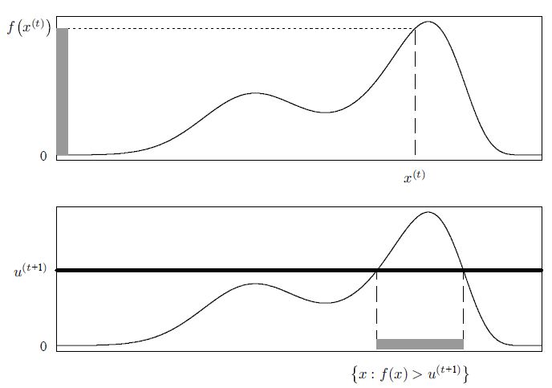
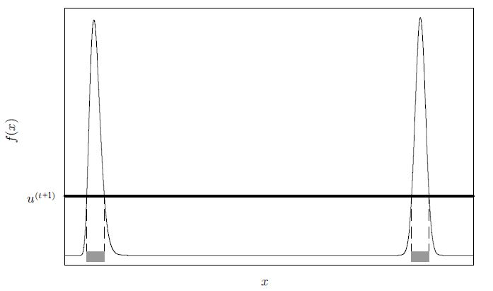

Slide 10
Perfect Sampling
Avoids all drawbacks and generate a chain that has exactly reached the stationary distribution
Challenges in implementing

Slide 11
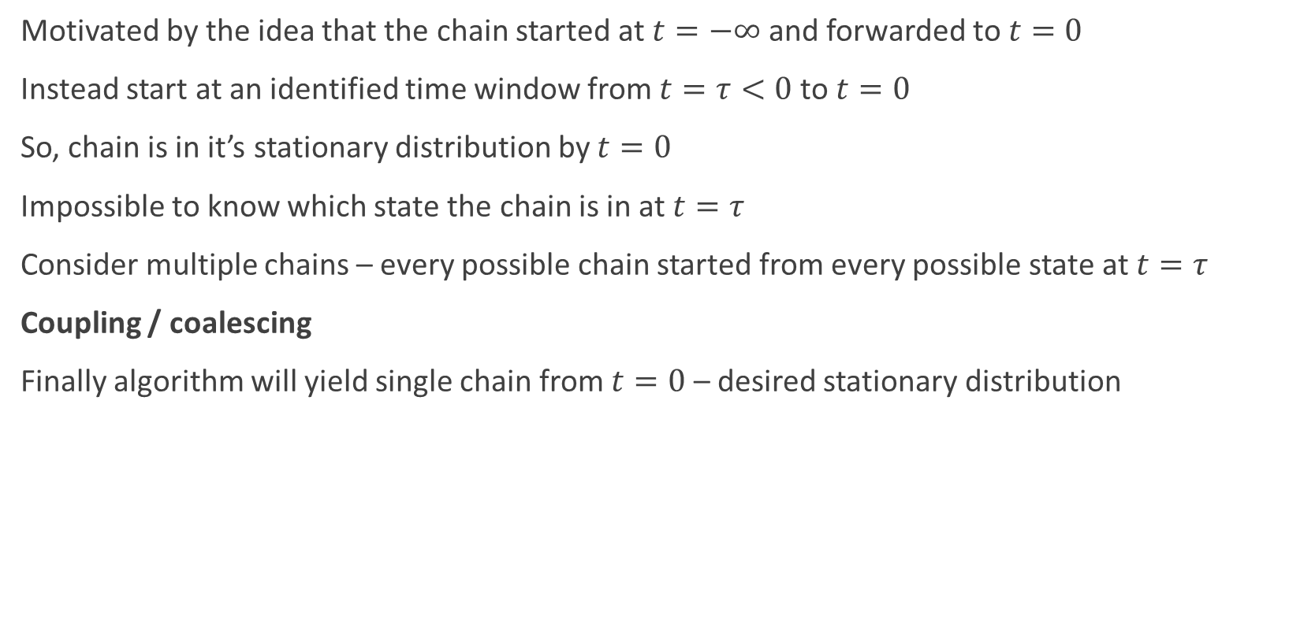
Coupling from the past (CFTP)
Motivated by the idea that the chain started at $t=−∞$and forwarded to $t=0$
Instead start at an identified time window from $t=τ<0$ to $t=0$
So, chain is in it’s stationary distribution by $t=0$
Impossible to know which state the chain is in at $t=τ$
Consider multiple chains – every possible chain started from every possible state at $t=τ$
Coupling / coalescing
Finally algorithm will yield single chain from $t=0$ – desired stationary distribution

Slide 12
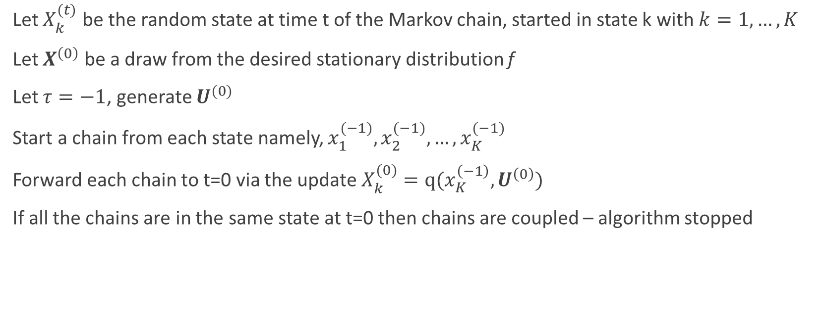
General Idea
Let $X_{k}^{(t)}$ be the random state at time t of the Markov chain, started in state k with $k=1,…,K$
Let $X^{\left(0\right)}$ be a draw from the desired stationary distribution f
Let $τ=−1$, generate $U^{(0)}$
Start a chain from each state namely, $x_{1}^{(−1)},x_{2}^{(−1)},…,x_{K}^{(−1)}$
Forward each chain to t=0 via the update $X_{k}^{(0)}=q(x_{K}^{\left(−1\right)},U^{\left(0\right)})$
If all the chains are in the same state at t=0 then chains are coupled – algorithm stopped

Slide 13

If not, Let $τ=−2$, generate $U^{(−1)}$
Start a chain from each state namely, $x_{1}^{(−2)},x_{2}^{(−2)},…,x_{K}^{(−2)}$
Forward each chain to t=0 via the updates $X_{k}^{(−1)}=q(x_{K}^{\left(−2\right)},U^{\left(−1\right)})$
then reusing $U^{(0)}$, generate $X_{k}^{(0)}=q(x_{K}^{\left(−1\right)},U^{\left(0\right)})$
If all the chains are in the same state at t=0 then chains are coupled – algorithm stopped
Otherwise – move the starting time back another step, $τ=−3$
Continue restarting the chains one step further back till all the chains are coalesced by t=0

Slide 14
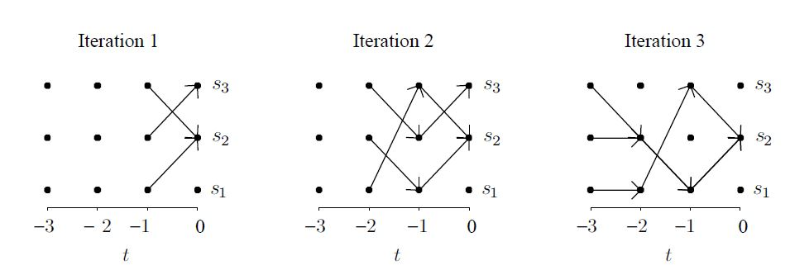
Example

Slide 15
References
Computational Statistics, 2nd edition; Givens and Hoeting,2013

